Slide 1
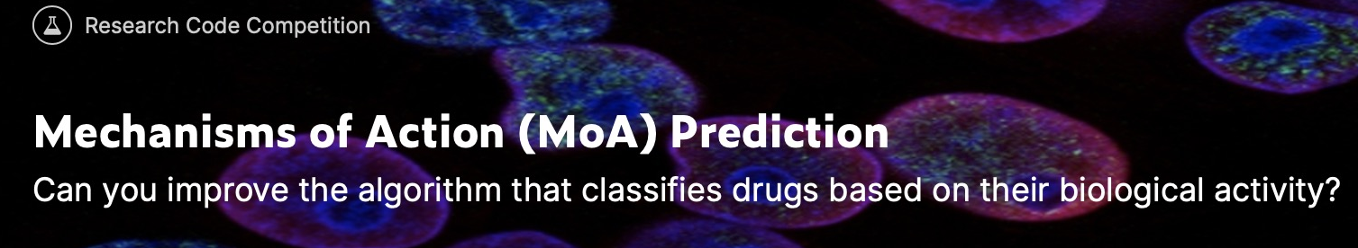

Capstone
Final
Report
Danlei Qian
December,2020
https://www.kaggle.com/c/lish-moa/overview

Slide 2
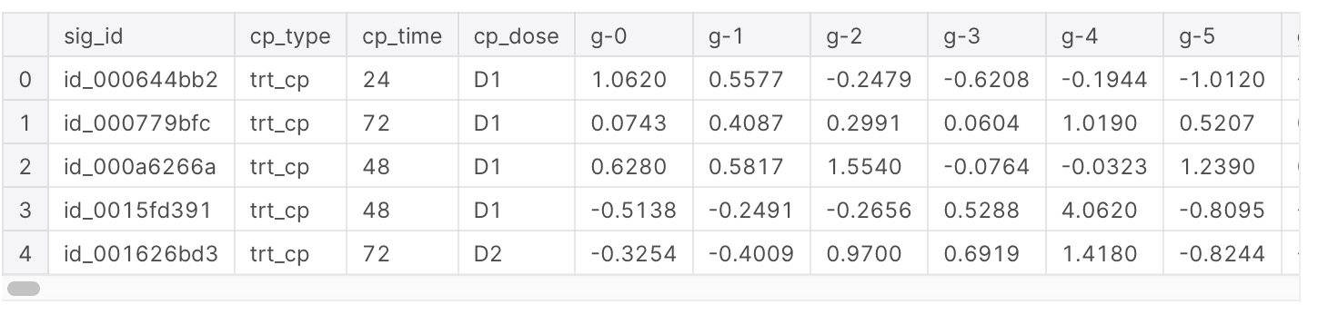
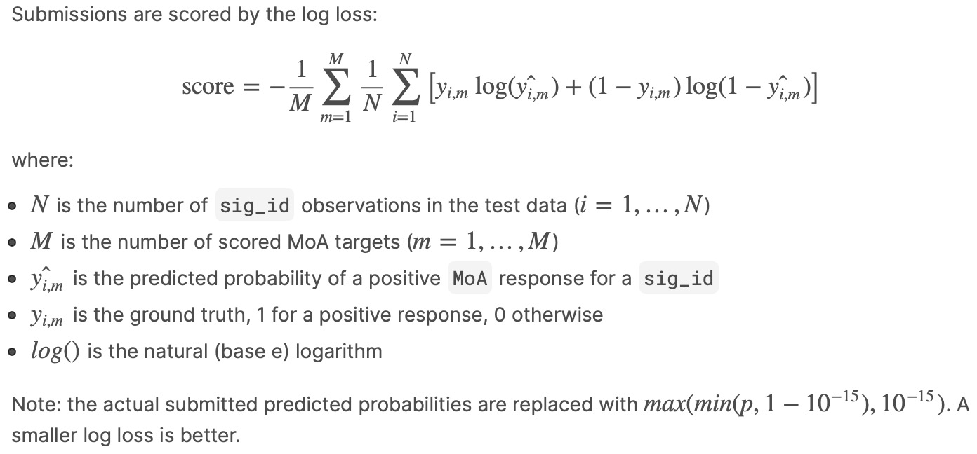
Overview
Kaggle competition
Object: Classify drugs based on their biological activity
This is a multi-label classification problem. Drugs can have multiple MoA annotations which describe binary responses from different cell types in different ways.
In this project, I would like to apply several machine learning algorithms to predict multiple targets of the MoA responses of different types of human cells to various drugs, given various inputs including gene expression data and cell viability data.
For every sig_id you will be predicting the probability that the sample had a positive response for each <MoA> target.
Evaluation:
Log loss

Slide 3
Datasets
Kaggle competition
Features g- signify gene expression data.
Features c- signify cell viability data.
cp_type indicates samples treated with a compound,
trt_cp samples treated with the compounds.
ctrl_vehicle control perturbations have no MoAs.
cp_time indicates treatment duration (24, 48, 72 hours)
cp_dose indicates treatment dose (high or low).
train_features.csv
(23814, 876)
876 features
test_features.csv
(3982, 876)
train_targets_scored.csv
(23814, 207)
207 targets
To be predicted
train_targets_nonscored.csv
(23814, 403)
403 targets
Not to be predicted (optional)
sample_submission.csv
(3982, 2)
test targets
train_drug.csv
(23814, 2)
additional
information

Slide 4
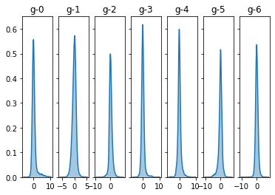
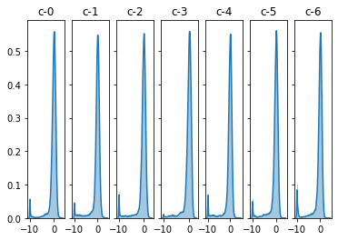
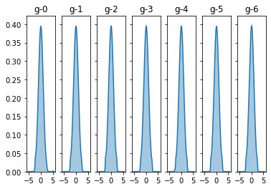
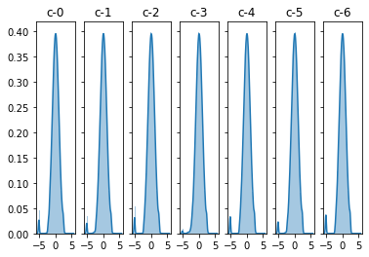
Scaling
Quantile Transformation
Skewed , Spike
Input normalization for neural networks is very important. Quantile Transformation is an effective way for converting numeric variable distributions to normal.
Normal Distribution

Slide 5
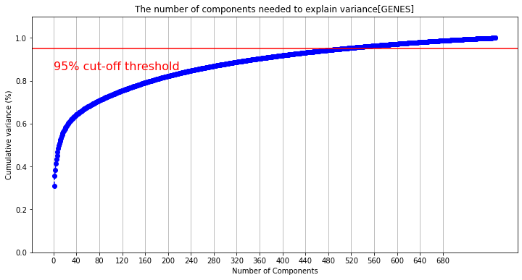
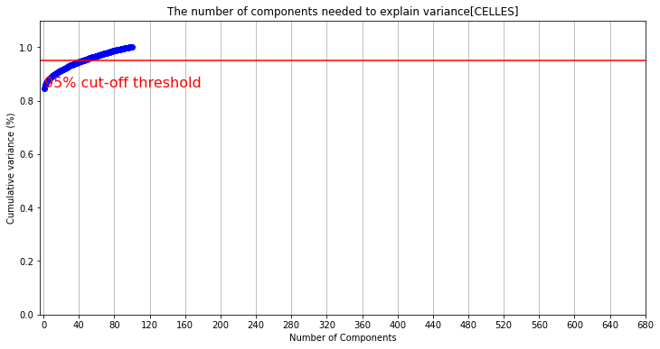
PCA
Dimensionality Reduction
Added features from PCA to existing ones
Number of components:
GENES:600
CELLS: 50
The number of components is chosen based on the 95% threshold of variance that can be explained.

Slide 6
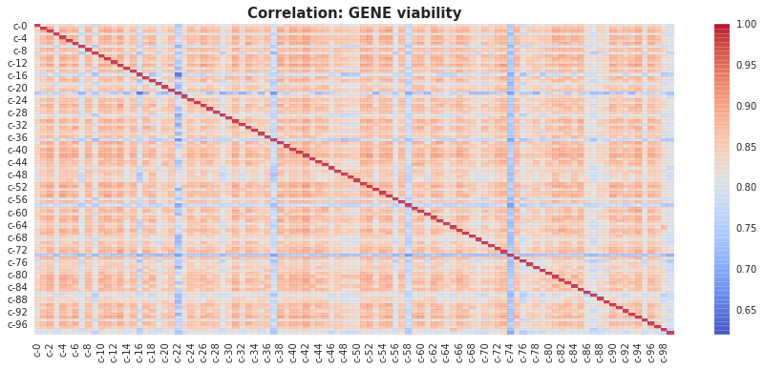
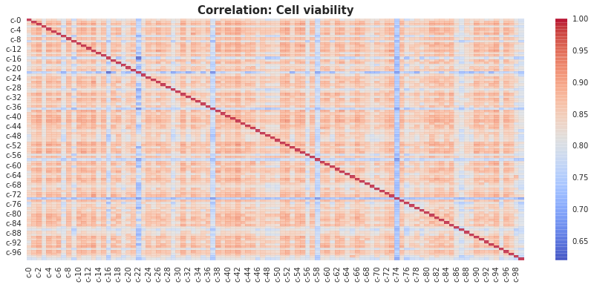


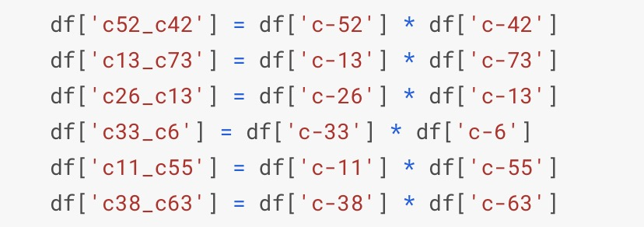
Feature Engineering
Correlation

Slide 7
Feature Engineering
Feature Importance
T-test
Adversarial Validation
LightGBM
Permutation Importance
(not used in best result)
P-value
AUC score
447 features
50 features
771 features
Reference
https://www.kaggle.com/demetrypascal/t-test-pca-rfe-logistic-regression
https://towardsdatascience.com/adversarial-validation-ca69303543cd
Two-Heads
ResNet NN
Two-Phase NN
With
Transfer Learning

Slide 8
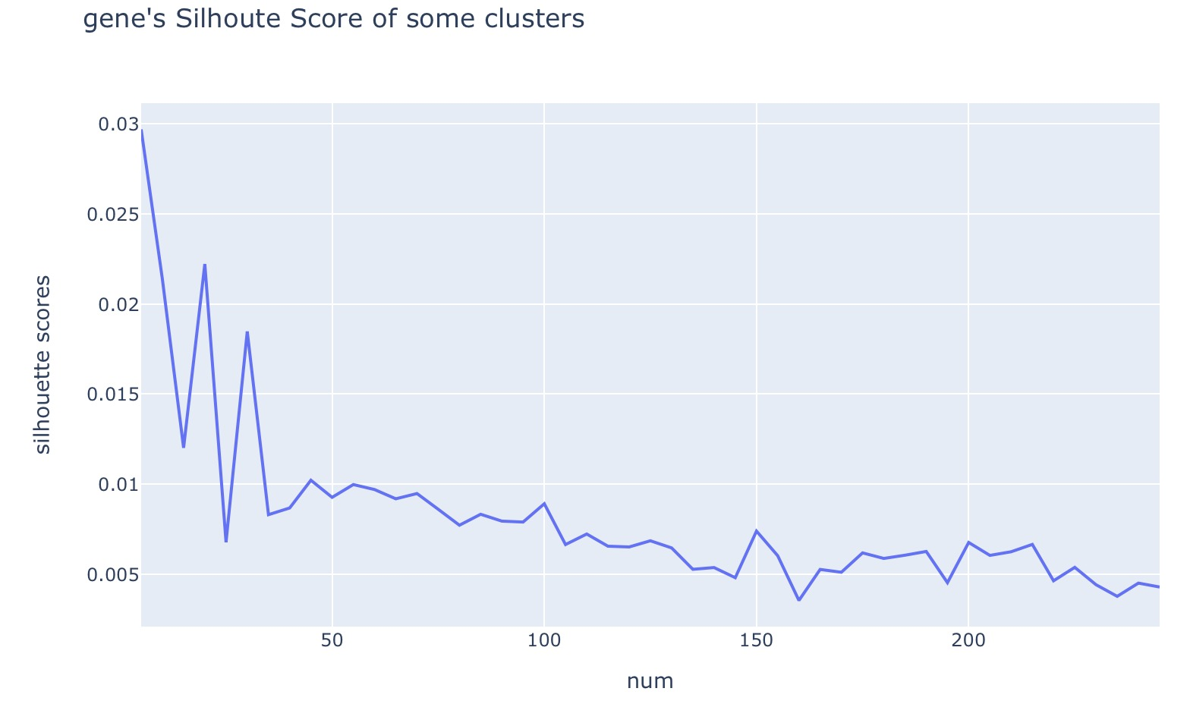
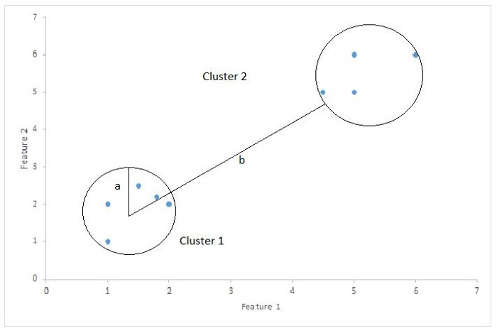
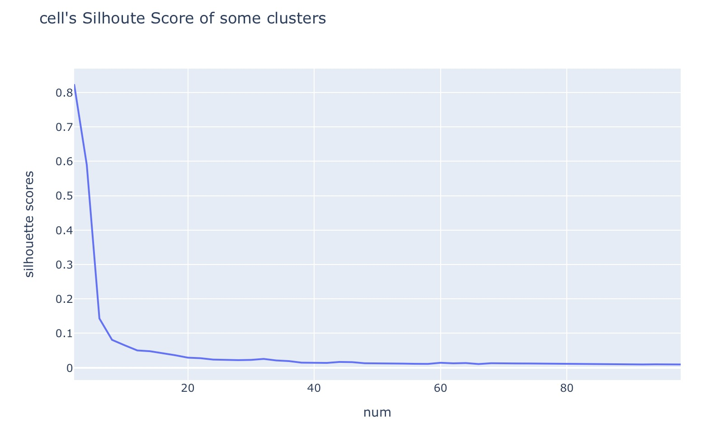
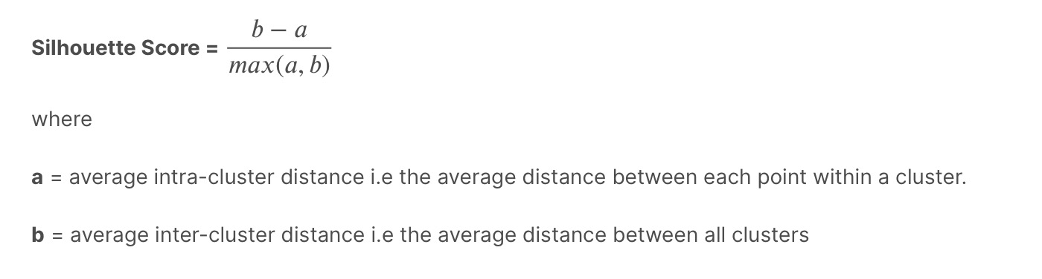
Feature Engineering
K-means
Deciding clusters in Kmeans- Silhouette Coefficient Silhouette Coefficient or silhouette score is a metric used to calculate the goodness of a clustering technique.
Its value ranges from -1 to 1 with 1 being the best and -1 being the worst.
from sklearn.metrics import silhouette_score
Reference:
https://www.kaggle.com/yerramvarun/deciding-clusters-in-kmeans-silhouette-coeff
https://towardsdatascience.com/silhouette-coefficient-validating-clustering-techniques-e976bb81d10c

Slide 9

Feature Engineering
Variance Threshold and Statistics Features
Feature selection using VarianceThreshold method of Sklearn
Features with a training-set variance lower than this threshold will be removed. The default is to keep all features with non-zero variance, i.e., remove the features that have the same value in all samples.
Statistics Features
Sum
Mean
Skew
Kurtosis
Std
Raw data
$$⊕$$

Slide 10
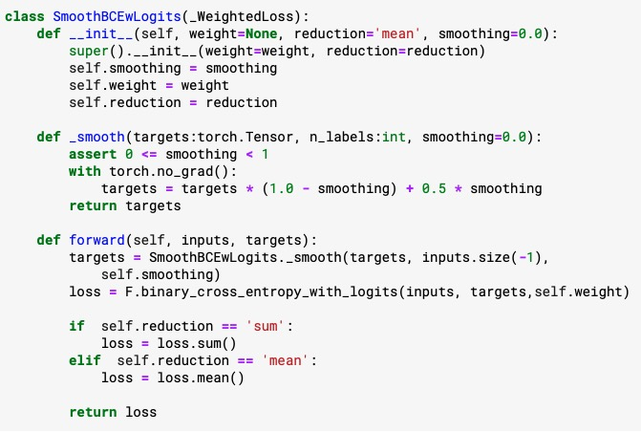
Modeling
Label Smoothing
Label smoothing is a regularization technique for classification problems that introduces noise for the labels to prevent the model from predicting the labels too confidently during training and generalizing poorly
Reference: https://leimao.github.io/blog/Label-Smoothing/

Slide 11
Modeling
Model Architecture Diagram
NN with non-score transfer learning
(CV with drug_id)
Tabnet
(CV without drug_id)
2-Heads Resnet NN
(CV without drug_id)
0.333
0.333
0.333
$$⊕$$
Ensemble
Cross-Validation Strategies
with
MultilabelStratifiedKFold
Model Architecture Diagram of Best Model

Slide 12

Modeling
NN with transfer learning
Preprocessing
Feature Engineer
Transfer Learning
Non-Scored
Targets
K-Means
Gene and Cell Features
Quantile
Transformer
PCA
Variance
Threshold
Phase 1
Base NN
Phase2
Base NN
Scored
Predictions
Statistical Features
Scored
Targets
Categorical Features
One-hot
Encoding
Two-Phase NN with Transfer Learning

Slide 13
Modeling
NN with transfer learning
unfreezed
Batch Norm
Dense(1500)
Leaky ReLU
Batch Norm
Dropout
Dense(1250)
Leaky ReLU
Batch Norm
Dropout
Dense(1000)
Leaky ReLU
Batch Norm
Dropout
Dense(750)
Leaky ReLU
Batch Norm
Dropout
Dense
Leaky ReLU
Input
Sigmoid
FC1
FC2
FC3
FC4
FC5
5-FC Base NN Block Topology

Slide 14
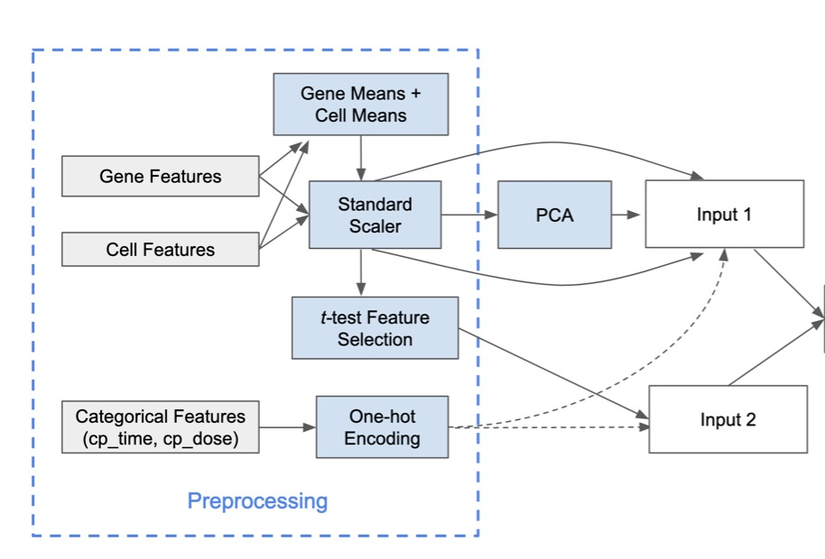

Modeling
Two-Heads ResNet NN
Scored
Targets
ResNet-like NN
Scored
Predictions
Two-Heads ResNet-like NN
Reference:
https://www.kaggle.com/c/lish-moa/discussion/201510

Slide 15
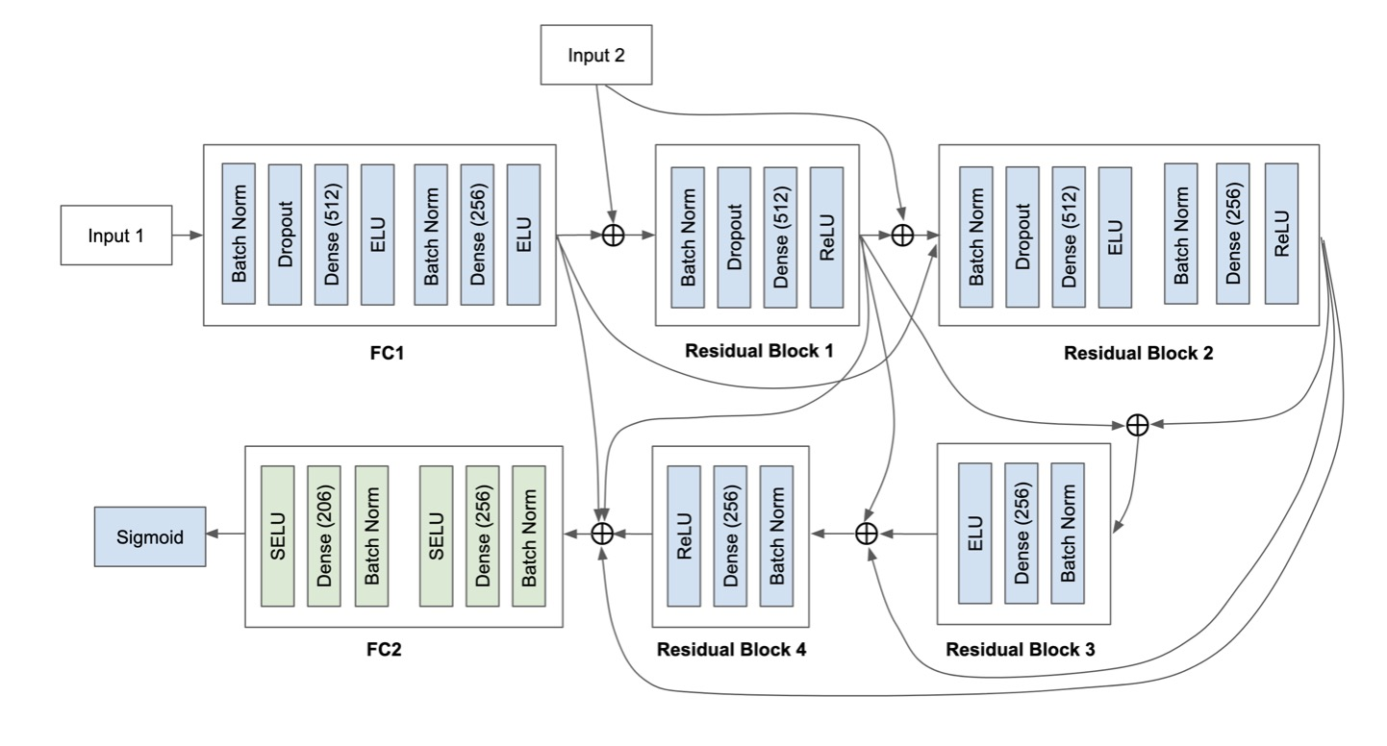
Modeling
Two-Heads Resnet NN
ResNet-like NN Topology(1)
Reference:
https://www.kaggle.com/c/lish-moa/discussion/201510

Slide 16
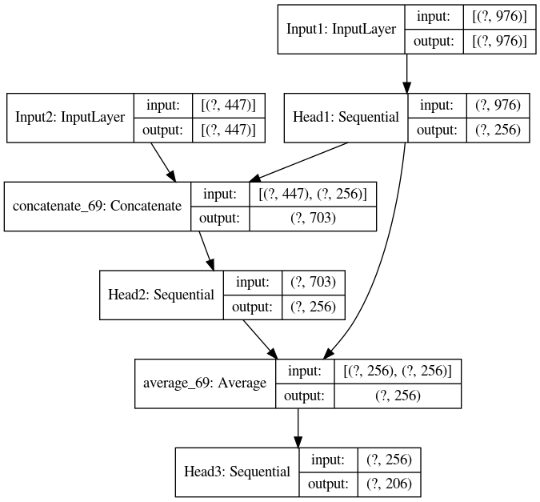
Modeling
Two-Heads Resnet NN
ResNet-like NN Topology(2)

Slide 17

Modeling
TabNet
Preprocessing
Feature Engineer
Scored
Targets
Gene and Cell Features
Variance Threhold
Rank Gauss
Scaler
PCA
TabNet
Scored
Predictions
Statistical Features
Categorical Features
One-hot
Encoding
ncompo_genes = 80
ncompo_cells = 10
Variance threshold = 0.7
TabNet Model

Slide 18
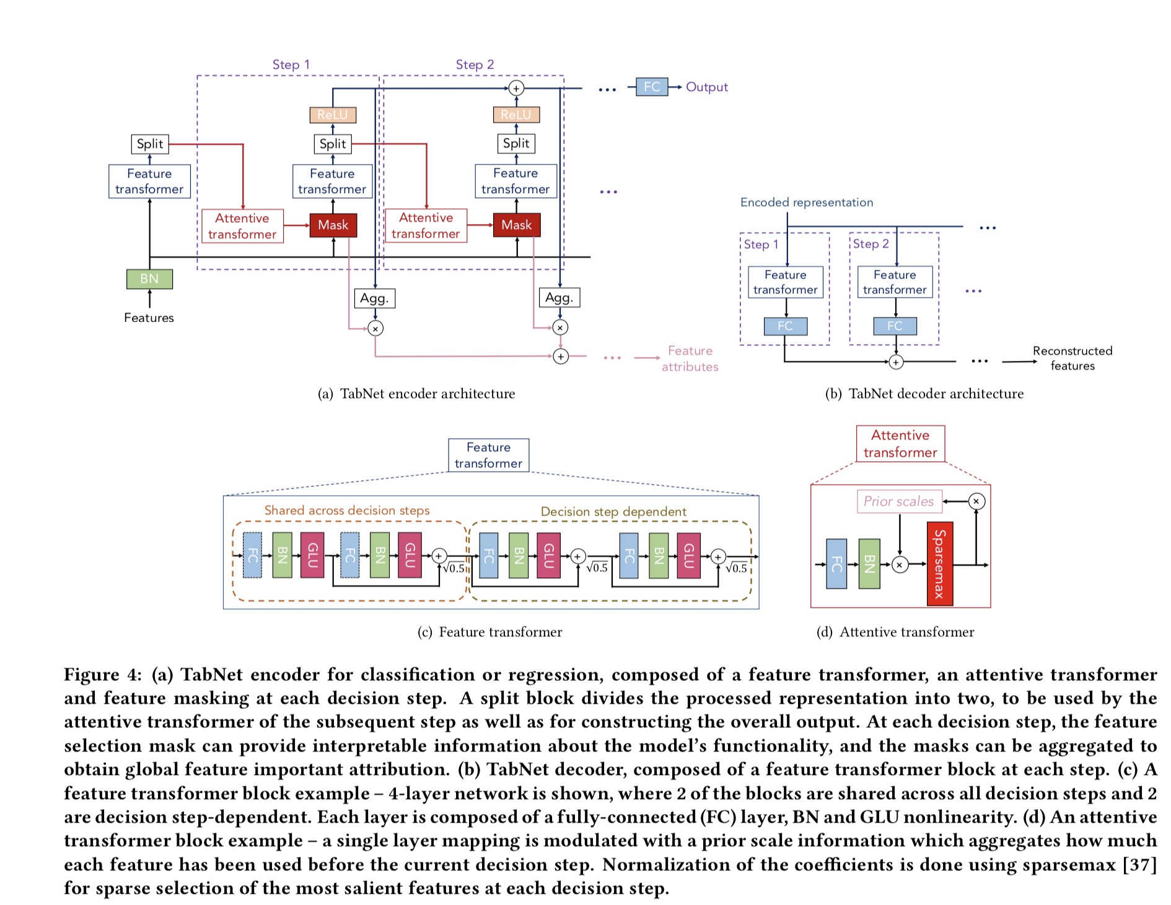
Modeling
TabNet
TabNet, that is designed to learn a ‘decision-tree-like’ mapping in order to inherit the valuable benefits of tree-based methods (interpretability and sparse feature selection), while providing the key benefits of DNN-based methods (representation learning and end-to-end training).
In particular, TabNet’s design considers two key needs: high performance and interpretability.
TabNet inputs raw tabular data without any feature preprocessing
Reference:
https://arxiv.org/pdf/1908.07442.pdf

Slide 19
Result
Single Model | Seeds | K-folds | Cross Validation without Drug_id | Cross Validation with Drug_id | Public Score | Private Score
Tabnet | 1 | 10 | 0.016717 |  | 0.01841 | 0.01632
2-Stage NN | 7 | 7 |  | 0.01563 | 0.01833 | 0.01623
2-Heads Resnet NN | 7 | 10 | 0.01656 |  | 0.01850 | 0.01635
Ensemble with average weights |  |  |  |  | 0.01824 | 0.01609

Slide 20
Summary and Future Work
Conclusion:
Model Ensemble is magic, and model diversity is important.
EDA and Feature Engineering is very important.
Hyperparameter Tuning is important but do not waste too much time on it.
Limitation and Future Work:
Not optimize the blending weights
Not implement Self-Supervised Pretraining with TabNet
Not implement transfer learning on Resnet
Find more effective way for hyperparameter tuning.
Code is not well-organized and needs more optimization

Slide 21
Any Questions?

